Slide 1

Subject Name: Logistics and Supply Chain Management
Session No: 01
Faculty Name: Prof Ajit M Maurya

Slide 2
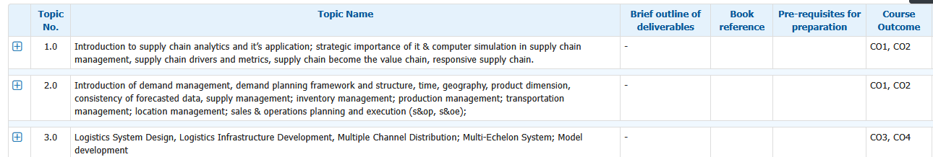

Slide 3
Agenda
Introduction to supply chain analytics and it’s application;
Strategic importance of it & computer simulation in supply chain management
Supply chain drivers and metrics
Supply chain become the value chain
Responsive supply chain.

Slide 4
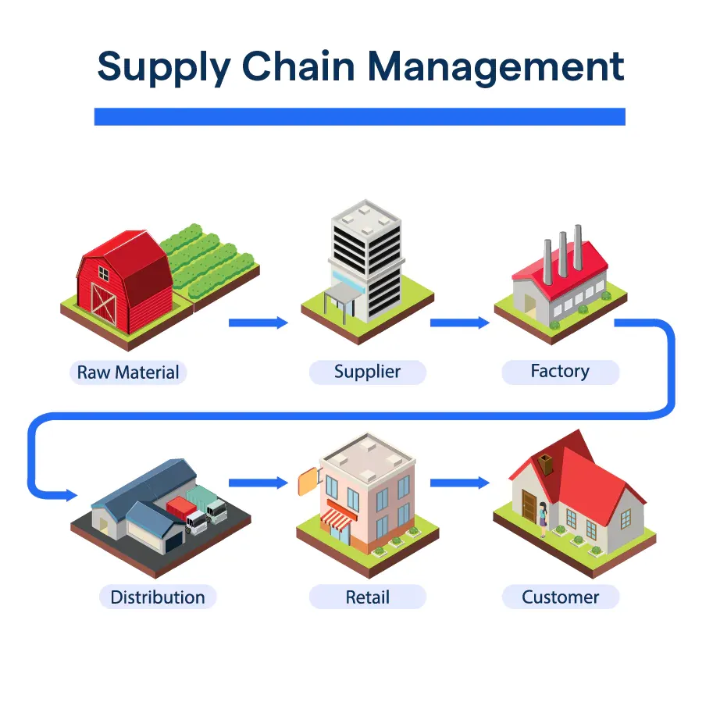
The Modern Supply Chain: From Foundational Process to Strategic Imperative
Supply Chain Management has evolved from a series of discrete operational tasks into a comprehensive and strategic management philosophy. This presentation explores how modern supply chains have become the critical engines driving commerce, ensuring products and services reach their destinations efficiently and effectively, while navigating an increasingly complex global landscape.

Slide 5






Part I: The Architecture of the Modern Supply Chain
Defining the Discipline: An Integrated Management Philosophy
A Comprehensive Strategic Discipline
Cross-Functional Coordination
Extensive Process Scope
Supply Chain Management (SCM) has evolved from discrete operational tasks into a strategic discipline aimed at creating competitive advantage through the integrated management of product journeys.
SCM requires seamless coordination of major business functions—marketing, sales, product design, finance, and IT—within an organisation and across networks of external partners.
The scope encompasses forecasting, demand planning, procurement, supplier management, operations, manufacturing, inventory management, warehousing, and logistics.
The Three Fundamental Flows
Information Flow
The bidirectional exchange of data including forecasts, orders, schedules, inventory levels, and status updates enabling coordination and data-driven decisions.
Material/Product Flow
The tangible movement of goods through the network, typically moving downstream from suppliers to manufacturers to customers, with reverse logistics managing returns.
Financial Flow
The movement of money and credit throughout the chain, typically flowing upstream, encompassing payment terms, credit arrangements, and invoicing systems.
The SCOR Digital Standard: A Universal Framework
The Supply Chain Operations Reference model provides a standardised methodology for describing, measuring, and evaluating supply chain performance. The latest SCOR Digital Standard (SCOR DS) represents a paradigm shift from a linear chain concept to a more synchronous and interconnected network model.

Slide 6
The Strategic Objectives: Balancing Competing Imperatives
Excellence in modern supply chain management is defined by an organisation's ability to strategically calibrate the balance between efficiency and cost reduction against resilience, agility, and customer value.
The Classic Pillars: Efficiency and Cost Reduction
The Modern Imperatives: Resilience and Agility
The Ultimate Arbiter: Customer Satisfaction
Historically focused on maximising efficiency and minimising costs through lean manufacturing, Just-in-Time (JIT) inventory, and sourcing from the lowest-cost global suppliers.
Resilience: The ability to withstand, adapt to, and recover from disruptions through contingency planning and supplier diversification.
Customers now demand low prices, speed, flexibility, and transparency. Supply chains that consistently deliver on promises by ensuring product availability, quality, and timely delivery build customer loyalty and brand reputation.
Agility: The capacity to respond quickly to unexpected changes in demand or supply, exemplified by Zara's fast-fashion model that can take designs from runway to retail stores in weeks.
Example: Walmart's business model leverages logistical techniques such as cross-docking and scale to drive down supplier costs, supporting its "Everyday Low Prices" promise.
35%
48%
72%
Efficient Chain Cost Focus
Agile Model Adopters
Customer-Driven Strategy
Proportion of companies prioritising cost reduction over all other factors
Organisations shifting to flexibility-focused supply chain models post-pandemic
Companies citing customer expectations as the primary driver of supply chain transformation
The strategic tension in modern supply chain management lies in balancing competing objectives. The aggressive pursuit of maximum cost efficiency directly undermines resilience, as demonstrated during the COVID-19 pandemic when hyper-efficient supply chains were the first to break.

Slide 7
Part II: The Evolution and Environment of Global Supply Chains
A Strategic Evolution: From Logistics to Boardroom Imperative
1990s–2000s: Integration and Globalisation
Pre-1960s: The Fragmented Era
The birth of formal SCM driven by ERP systems, global outsourcing, and e-commerce. Amazon's 1995 launch was a watershed moment, fundamentally changing customer expectations.
Operations were highly localised with discrete functions like transportation and warehousing managed separately with little strategic integration.
1
2
3
4
1960s–1980s: The Rise of Logistics
2010s–Present: Digitalization and Resilience
Physical distribution emerged as a unified function. IBM developed the first computerised inventory management in 1963, and JCPenney implemented the first real-time Warehouse Management System in 1975.
Industry 4.0 technologies including AI, IoT, and robotics enabling new levels of optimisation, while global shocks like COVID-19 exposed vulnerabilities in lean supply chains.
Supply chain management's evolution follows a trajectory of increasing integration and abstraction, enabled by technological leaps. Each advancement expanded the scope of what could be controlled and optimised, transforming SCM from a tactical function into a source of strategic advantage.

Slide 8
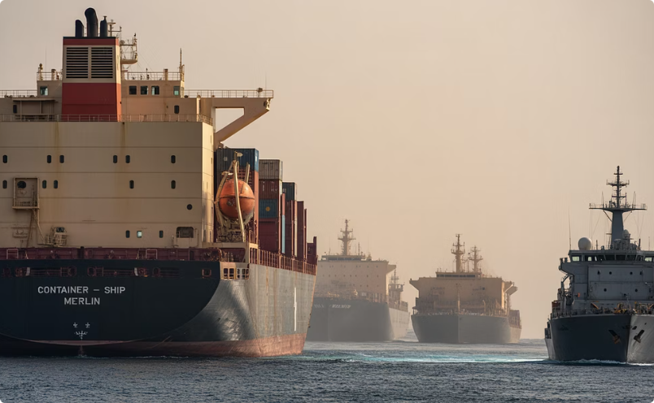
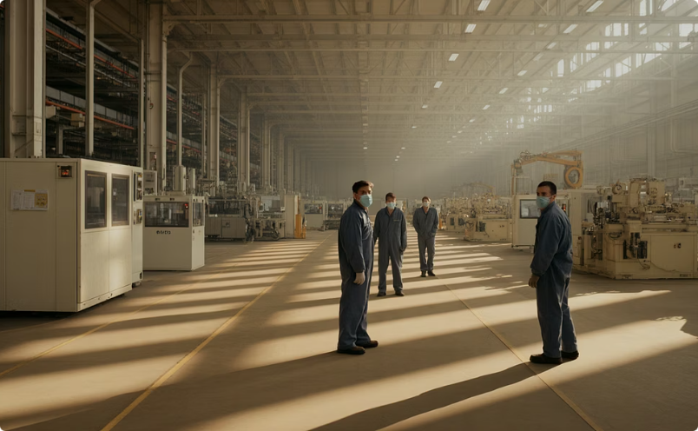
Navigating the Modern Risk Landscape
The contemporary supply chain operates in an environment of unprecedented volatility and complexity. Risk management is no longer a secondary compliance function but a primary driver of supply chain design and strategy.
Systemic Risk in Hyper-Efficient Chains
The relentless pursuit of efficiency has created complex, interconnected networks with minimal buffers. Practices like lean manufacturing, JIT inventory, and single-sourcing have systematically stripped out redundancy in the name of cost reduction.
This creates systemic risk: the danger that a localised disruption can trigger cascading failures across the entire network. The 2021-2022 semiconductor shortage exemplifies how disruptions at key foundries caused massive economic losses across multiple industries.
Rising Customer Expectations
Red Sea Shipping Crisis 2024
Pandemic-Induced Shocks
COVID-19 created simultaneous disruption to supply and demand globally. 72% of companies reported negative effects on their supply chains, with only 2% feeling fully prepared.
The "Amazon Effect" has permanently shifted customer expectations toward unprecedented speed, transparency, and low-cost delivery. High performance is no longer a differentiator but the minimum requirement for competing, with brand loyalty becoming increasingly fragile.
Attacks on vessels forced rerouting around Africa, adding 10 days and 4,000 miles to Asia-Europe voyages. Freight costs surged by 350%, contributing up to 0.7 percentage points to global inflation.
This challenging environment forces a strategic re-evaluation, shifting focus from optimising stable systems to building resilient networks capable of navigating constant disruption.

Slide 9
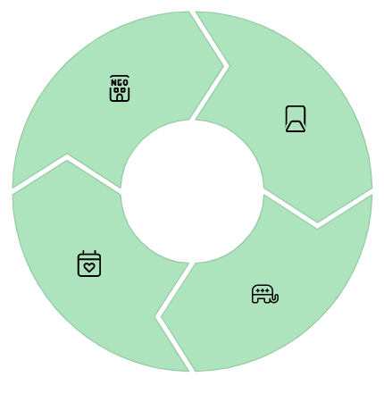



The Sustainability Imperative: ESG and the Circular Economy
Supply chains are increasingly judged on their environmental, social, and governance (ESG) performance.
This sustainability imperative is a core strategic issue with profound financial, operational, and reputational implications.
Regulatory Pressure
Investor Pressure
Governments worldwide implementing stringent regulations on supply chain impacts, including ESG reporting, deforestation-free products, and human rights due diligence.
More than 90% of S&P 500 companies publish ESG reports as investment communities embrace these criteria for evaluating performance and risk.
Talent Acquisition
Consumer Demand
The majority of employees, especially younger generations, prefer to work for environmentally and socially responsible companies.
An estimated 44% of consumers are "purpose-driven," choosing brands whose values align with their own and demanding transparency in sourcing and production.
The Three Pillars of a Sustainable Supply Chain
The Green Supply Chain
The Circular Supply Chain
The Ethical Supply Chain
Minimising environmental impact through reduced emissions, resource conservation, and eco-friendly transportation. Must address the rebound effect where efficiency gains lead to increased consumption.
Shifting from "take-make-dispose" to closed-loop systems through design for circularity, reuse programmes, recycling, and technology enablement like IoT for monitoring product condition.
Ensuring fair labour practices, human rights, worker safety, and positive community impact. Addressing the "dark side of lean" where cost pressures incentivise cutting corners on welfare.
The sustainability imperative is deeply intertwined with core strategic objectives. Poor ESG performance is a direct source of financial, operational, and reputational risk. A sustainable and ethical supply chain enjoys stronger brand reputation, attracts superior talent, and is more favourably viewed by investors and consumers.

Slide 10



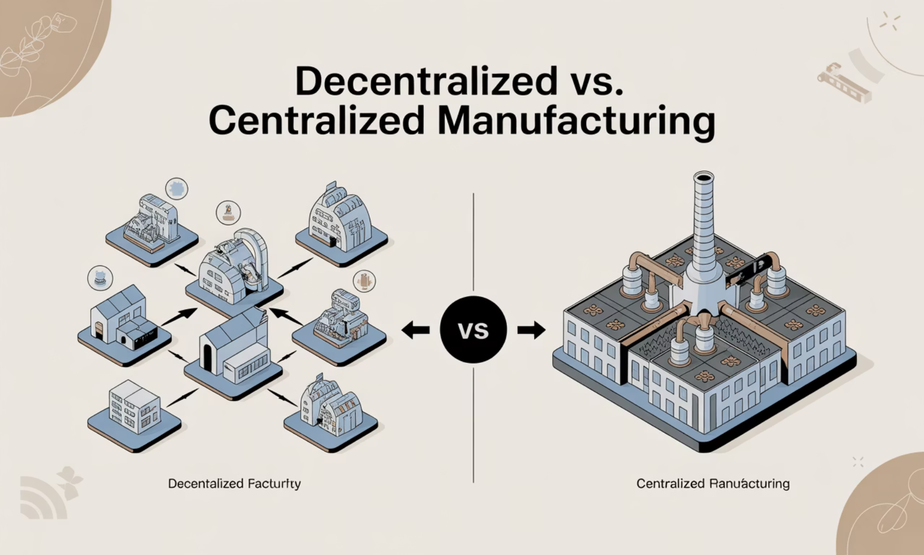
Part III: Levers of Competitive Advantage
Strategic Frameworks for a Complex World
Effective supply chain management in a volatile environment requires structured, analytical approaches to decision-making.
Several key frameworks have become indispensable tools for strategists.
SCOR Framework
Total Cost of Ownership
Network Design
Translates strategic goals into measurable operational metrics across five attributes: Reliability, Responsiveness, Agility, Costs, and Asset Management. Enables data-driven assessment and benchmarking against industry standards.
Shifts focus from purchase price to total lifecycle costs, including acquisition, operation, and end-of-life expenses. Advanced models incorporate risk-adjusted costs for factors like geopolitical instability and IP theft exposure.
Focuses on creating agile, resilient supply chains through decentralisation. The "China Plus One" strategy exemplifies this approach, diversifying manufacturing and sourcing beyond China to countries like Vietnam, India, and Mexico.
Agility vs Resilience: Key Distinctions
Resilience
A state of readiness achieved through proactive risk planning and diversification, enabling systems to withstand disruptions
Agility
A capability enabling rapid response to change, such as flexible manufacturing systems that can quickly switch between products
Decentralised manufacturing reduces transportation costs and lead times, improves local market responsiveness, and increases resilience by eliminating single points of failure.

Slide 11


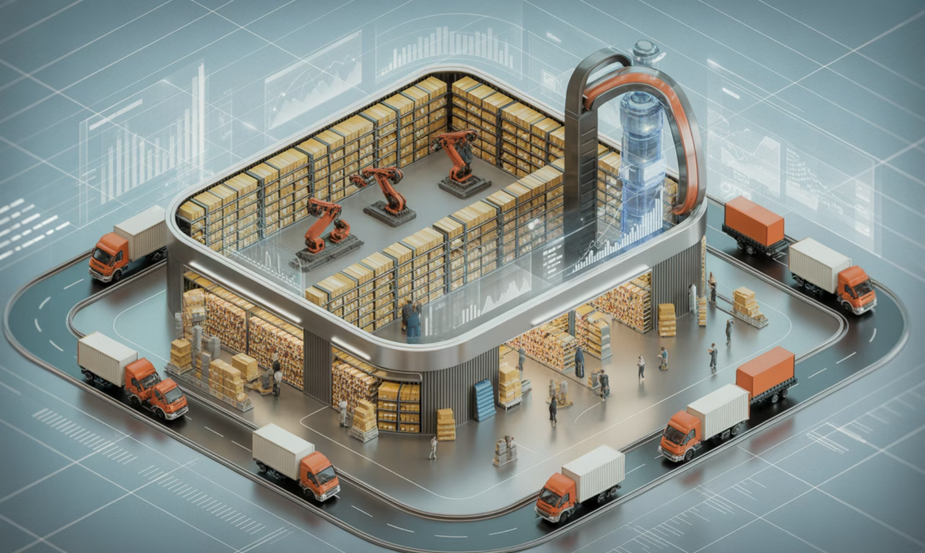
The Digital Transformation of the Supply Chain
The modern supply chain is being fundamentally reshaped by digital technologies that enable a shift from reactive management to predictive and autonomous operations.
1
Artificial Intelligence & Machine Learning
The intelligent engine powering advanced applications in demand forecasting, logistics optimisation, and risk management
2
Internet of Things (IoT)
The digital nervous system connecting physical and digital worlds through sensors that provide real-time data on
location and condition
3
Big Data & Advanced Analytics
The foundation that turns vast information into actionable insights for efficiency, cost reduction, and resilience
Key AI Applications in Supply Chain
Demand Forecasting using XGBoost, Random Forest, and hybrid neural networks to analyze historical sales, market trends, and external factors
Logistics Optimization through Reinforcement Learning for dynamic routing problems, learning optimal policies through trial and error
Risk Management using Natural Language Processing to scan unstructured text for early warning signals of disruptions
Blockchain: The Layer of Trust
Integrated Systems: Digital Twins and Control Towers
Blockchain provides a distributed, immutable ledger that enhances traceability and transparency. Walmart's implementation reduced the time to trace a package of mangoes from seven days to 2.2 seconds, enabling rapid, precise recalls during safety issues.
Digital Twin
A virtual replica of physical assets or processes continuously updated with real-time data, enabling safe "what-if" simulations without real-world risk.
Supply Chain Control Tower
A centralized hub combining people, processes, data, and technology to provide end-to-end visibility and enable collaborative, data-driven decision-making.

Slide 12
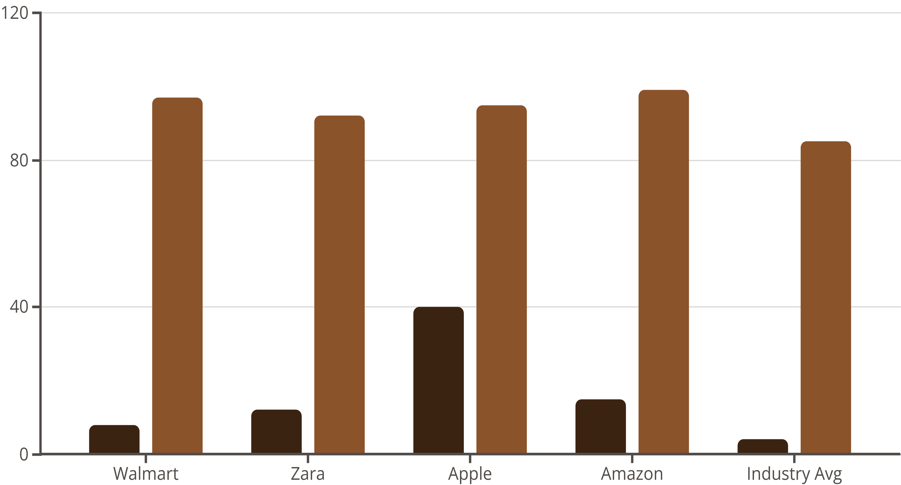
Case Studies in Strategic Execution
World-class supply chains are meticulously designed to support specific corporate strategies. Four industry titans demonstrate how different strategic objectives are realized
through unique combinations of operational tactics and technology.
Walmart: Relentless Cost Efficiency
Core Strategy: Cost leadership enabling "Everyday Low Prices"
Key Tactics: Cross-docking, private truck fleet, Vendor-Managed Inventory, and continuous technology adoption
Outcome: Hyper-efficient, low-cost supply chain enabling market saturation with 90% of Americans living within 15 minutes of a store
Apple: Global Complexity Management
Core Strategy: Product innovation, premium quality, and seamless customer experience
Key Tactics: Strategic sourcing, multi-supplier resilience, vertical integration of core technology, and JIT manufacturing
Outcome: Negative cash conversion cycle (averaging -64 days) and low inventory levels (9-12 days) contributing to enormous profitability
Zara: Fast-Fashion Agility
Core Strategy: Speed and responsiveness to fast-changing fashion trends
Key Tactics: 15-day design-to-retail cycle, vertical integration, near-sourcing, and
small-batch production
Outcome: 12x inventory turnover (vs. industry average of 3-4) and 85% of items
sold at full price (vs. industry average of 60%)
Amazon: Technology-Driven Fulfillment
Core Strategy: Obsessive customer centricity delivered through speed
Key Tactics: Distributed fulfillment network, pioneering robotics, AI-driven
logistics, and Supply Chain as a Service
Outcome: Click-to-delivery speed reduced by over 50% and increased
e-commerce conversion through reliable fast-delivery estimates
Each supply chain is uniquely configured to deliver a specific competitive advantage:
Walmart on cost, Zara on speed, Apple on quality, and Amazon on customer fulfillment.
Inventory Turnover
On-Time Delivery %

Slide 13
Part IV: The Future of Supply Chain Management
The Next Frontier: Emerging Concepts and Technologies
The Physical Internet (PI): Reimagining Global Logistics
The Physical Internet envisions an open, global logistics system functioning analogously to the digital internet. Physical goods in standardized, smart containers would move seamlessly across a shared network of logistics hubs, dramatically improving efficiency and sustainability.
2025
1
Standardized smart containers and initial protocol development for interoperability between logistics networks
2
2030
Widespread network interconnectivity with shared logistics assets and collaborative transportation systems
2040
3
Fully autonomous Physical Internet with self-organizing logistics networks optimized for efficiency and sustainability
The Rise of Autonomous Supply Chains
The convergence of AI, IoT, and robotics is paving the way for autonomous supply chains that can plan, execute, and optimize with minimal human intervention, encompassing AI-driven planning, automated procurement, "lights-out" warehouses, and autonomous delivery.
Advanced AI Applications
Beyond predictive AI, we're moving toward generative and agentic AI that can create novel solutions and take autonomous actions to achieve high-level goals, such as optimizing logistics costs while maintaining service levels.

Slide 14

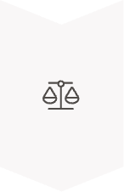


The Indispensable Human Element
The Future of SCM Professionals
Technology isn't making human expertise obsolete but elevating it toward higher-level strategic, creative, and ethical responsibilities that are more critical than ever.
The Great Shift: From Tactical to Strategic
New Core Competencies
AI and automation are offloading repetitive, data-intensive, and transactional work, liberating human professionals to focus on high-value activities machines cannot perform well.
Human-Machine Teaming: Designing, managing, and working alongside intelligent systems, knowing when to trust AI recommendations and when to override them
Strategic Decision-Making
Leadership and Emotional Intelligence: Guiding teams through constant change and fostering a culture of continuous learning and adaptation
Setting objectives and aligning supply chain strategy with broader corporate goals based on contextual understanding and long-term vision
Emerging Supply Chain Careers
Ethical Oversight
Designing ethical frameworks, auditing AI systems for fairness and bias, and ensuring accountability for automated decisions
Complex Problem-Solving
Navigating novel, unprecedented disruptions requiring creativity, adaptability, intuition, and
empathetic leadership
The paradox of the AI-driven supply chain is that it makes human judgment more, not less, valuable.
While AI excels at "how" questions, humans must answer the far more difficult questions of "what" and "why".
Supply Chain Data Scientists
AI Ethics and Bias Analysts
Digital Twin Operators
Robotics Fleet Managers

Slide 15



The Strategic Imperative of Technology in Modern SCM
Information Technology (IT) and computer simulation have evolved from back-office support functions into core strategic pillars of effective Supply Chain Management. Together, they empower organisations to enhance efficiency, improve visibility, bolster resilience, and make smarter, data-driven decisions.
Core IT Systems in Supply Chain Management
Key Benefits of IT Integration
Enterprise Resource Planning (ERP)
The central nervous system integrating all major functions into a unified platform, providing a holistic view of the entire supply chain.
Enhanced Visibility and Transparency
ERP, WMS, and TMS systems provide real-time data on inventory, orders, and shipments, allowing managers to track goods and proactively identify potential bottlenecks.
Improved Operational Efficiency
Warehouse Management Systems (WMS)
Automation of routine tasks reduces errors, saves time, and frees human resources for strategic activities while optimising transportation routes and inventory levels.
Specialised software controlling warehouse operations through barcoding and RFID for real-time tracking and process automation.
Superior Collaboration
Modern IT platforms break down silos and enable seamless collaboration among all supply chain partners through shared information sources.
Transportation Management Systems (TMS)
Focused on logistics, optimising shipping routes, selecting cost-effective carriers, and tracking shipments in real-time.
Data-Driven Strategic Decision-Making
IT provides the foundation for advanced analytics, allowing companies to leverage Big Data, AI, and Machine Learning. These technologies analyze vast datasets to produce more accurate demand forecasts, identify emerging risks, and optimize complex processes, shifting from reactive problem-solving to proactive, predictive management.

Slide 16
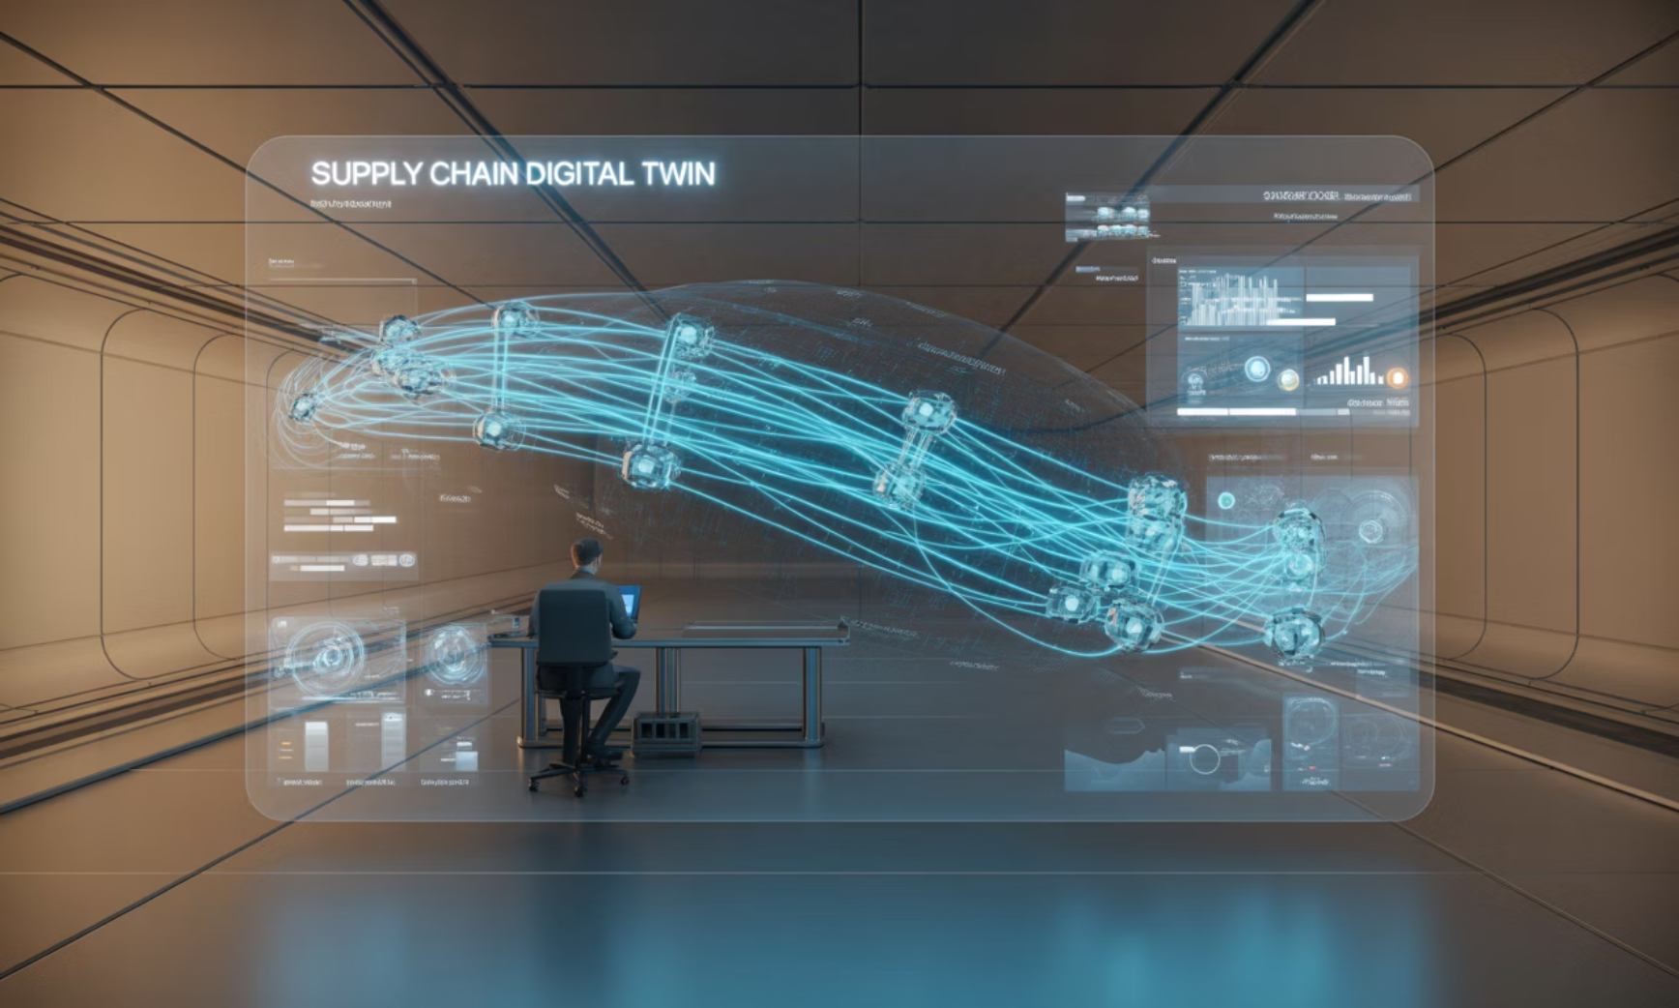



The Power of Computer Simulation in Supply Chain Strategy
While IT provides the data and infrastructure, computer simulation provides strategic foresight. Creating a dynamic, computer-based model of a supply network allows organisations to experiment and stress-test in a risk-free environment, accounting for complex interdependencies that analytical models often cannot capture.
The Digital Twin: Ultimate Technology Synergy
Key Applications and Benefits
Strategic Network Design
Modelling different scenarios for factory, warehouse, and distribution centre locations to balance cost, service levels, and lead times.
Inventory Optimization
Testing various inventory policies to understand their impact on holding costs and service levels, minimising both stockouts and costly overstocks.
Risk Management
Running "what-if" scenarios to model the impact of disruptions like supplier failures or natural disasters, identifying vulnerabilities and developing contingency plans.
A digital twin is a virtual replica of a physical supply chain continuously updated with real-time data from IT systems and IoT sensors. This creates a dynamic, high-fidelity simulation that allows managers to not only visualize current operations but also run simulations and test scenarios based on live data.
Gartner predicts that by 2028, 15% of large enterprises will have embedded intelligent simulation in their operations, with the digital twin serving as the foundation.
Implementation Challenges
Despite clear benefits, adoption faces hurdles including significant upfront costs, integration complexity with legacy systems, organisational resistance to change, and skills shortages for effectively managing these sophisticated systems.

Slide 17




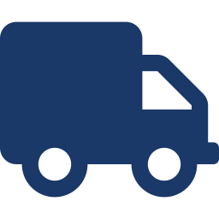
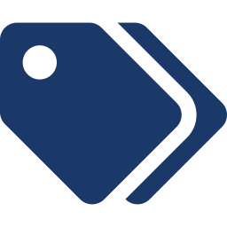
THEORY
The Six Supply Chain Drivers
Every supply chain's performance in terms of responsiveness and efficiency is determined by how well it manages six drivers — three logistical and three cross-functional (Chopra & Meindl framework). A firm designs the level of each driver to achieve the desired strategic fit between competitive strategy and supply chain strategy.
LOGISTICAL DRIVERS
CROSS-FUNCTIONAL DRIVERS
Facilities
Information
Where product is made, stored, or serviced — location, capacity and flexibility choices.
Data and analysis on facilities, inventory, transport, customers used to make decisions.
Inventory
Sourcing
Raw material, WIP and finished goods held across the chain to buffer against uncertainty.
Set of processes to procure goods/services — who performs which activity, make or buy.
Transportation
Pricing
Movement of inventory between stages — mode, network and routing decisions.
How much a firm charges for goods/services, shaping buyer behaviour and demand patterns.
Supply Chain Management
4

Slide 18
DIAGRAM
Drivers of Supply Chain Performance
Facilities
Reading the model
Each driver can be tuned toward efficiency (low cost) or responsiveness (speed, flexibility).
The combined setting of all six drivers determines a supply chain's overall position on the efficiency-responsiveness spectrum, and hence its strategic fit with business goals.
STRATEGIC
FIT
Pricing
Transportation
Sourcing
Inventory
Information
Supply Chain Management
5

Slide 19
THEORY
Each Driver Has an Efficiency–Responsiveness Trade-off
Driver | Efficiency Focus (Low Cost) | Responsiveness Focus (Speed/Flexibility)
Facilities | Few large, centralized plants/warehouses for economies of scale | Many smaller, local facilities close to customers
Inventory | Low inventory levels held across the chain | High inventory / buffer stock to absorb demand swings
Transportation | Low-cost modes: rail, sea, full-truckload (FTL) | Fast modes: air freight, less-than-truckload (LTL), premium courier
Information | Lower investment in information sharing systems | High investment in real-time data, visibility & analytics
Sourcing | Select suppliers mainly for low cost | Select suppliers mainly for speed, flexibility, reliability
Pricing | Stable, low pricing to encourage predictable demand | Dynamic pricing to manage/shape variable demand
Supply Chain Management
6

Slide 20
NUMERICAL METRICS
10 Key Supply Chain Metrics — Part I
# | Metric | Formula | What It Shows
1 | Inventory Turnover Ratio | COGS ÷ Average Inventory Value | How many times inventory is sold and replaced in a period; higher = more efficient inventory use.
2 | Order Fill Rate | (Orders Fully Shipped ÷ Total Orders) × 100 | Percentage of customer orders fulfilled completely from available stock, first time.
3 | On-Time Delivery (OTD) % | (On-Time Deliveries ÷ Total Deliveries) × 100 | Reliability of the transportation and fulfilment process against promised dates.
4 | Perfect Order Rate | % On-time × % Complete × % Damage-free × % Accurate Docs | Composite measure of flawless order execution across every dimension.
5 | Cash-to-Cash Cycle Time | DIO + DSO − DPO (in days) | Days between paying suppliers and collecting cash from customers; lower ties up less working capital.
Supply Chain Management
7

Slide 21
NUMERICAL METRICS
10 Key Supply Chain Metrics — Part II
# | Metric | Formula | What It Shows
6 | Transportation Cost % of Sales | (Total Freight Cost ÷ Net Sales Revenue) × 100 | Share of revenue consumed by logistics/transport; tracks cost efficiency of distribution.
7 | Warehouse Capacity Utilization | (Space/Volume Used ÷ Total Available Capacity) × 100 | How intensively storage capacity is used; guides facility expansion or consolidation decisions.
8 | Forecast Accuracy (via MAPE) | MAPE = (Σ |Actual − Forecast| / Actual) ÷ n × 100 | Error between forecasted and actual demand; lower MAPE means more reliable planning.
9 | Total Supply Chain Cycle Time | Sum of lead times: sourcing + production + delivery | Total time from raw-material order to final customer delivery; a core speed indicator.
10 | Return on Supply Chain Fixed Assets | Supply Chain Revenue ÷ Net Value of SC Fixed Assets | Revenue generated per rupee invested in supply chain infrastructure (plant, warehouse, fleet).
Takeaway: Metrics 1–5 emphasize execution reliability (fulfilment, delivery, cash flow), while metrics 6–10 emphasize cost, capacity and planning accuracy. Together they let managers track both the efficiency and responsiveness of the six drivers discussed earlier.
Supply Chain Management
8

Slide 22

SECTION 2
Supply Chain Becomes the Value Chain
From a linear cost-minimizing pipeline to an integrated, value-creating network

Slide 23



THEORY
Why 'Supply Chain' Is Becoming 'Value Chain'
The traditional supply chain view treated logistics as a cost centre — a linear sequence of push activities from raw material to finished goods. Michael Porter's Value Chain model (1985) reframed this: every activity — inbound logistics, operations, outbound logistics, marketing & sales, and service — should add value the customer is willing to pay for, supported by infrastructure, HR, technology and procurement.
From Push to Pull
Integration Over Silos
Value, Not Just Cost
Activities are triggered by customer demand and value creation, not just by moving product forward.
Suppliers, manufacturers, distributors and retailers act as one coordinated value-creating network.
Every stage is judged by the value/margin it contributes, not only by the cost it avoids.
In short: a supply chain moves products efficiently; a value chain uses that same movement to deliberately build competitive advantage and customer value at each step.
Supply Chain Management
10

Slide 24
DIAGRAM
Porter's Value Chain Model
SUPPORT ACTIVITIES
Firm Infrastructure (planning, finance, general management)
Human Resource Management (recruiting, training, compensation)
Technology Development (R&D, IT systems, process automation)
Procurement (purchasing inputs, supplier management)
PRIMARY ACTIVITIES
Inbound
Logistics
Operations
Outbound
Logistics
Marketing
& Sales
Service
Receiving, warehousing & inventory control of inputs
Transforming inputs into finished goods/services
Order fulfilment, warehousing & distribution to buyers
Advertising, promotion, pricing & channel selection
Installation, repair, training & customer support
MARGIN
Value chain logic: Primary activities create and deliver the product; support activities enable them. The cumulative value created, minus the cost of performing these activities, determines the firm's margin — the essence of competitive advantage.
Supply Chain Management
11

Slide 25
DIAGRAM
From a Linear Chain to a Value Network
TRADITIONAL SUPPLY CHAIN
INTEGRATED VALUE CHAIN
Linear · sequential · cost-focused
Networked · collaborative · value-focused
Retailer
Supplier
Manufacturer
Distributor
Retailer
Customer
Supplier
Customer
Value
→ One-directional flow of material, driven by forecasts pushed downstream
Distributor
Manufacturer
• Goal: minimize cost
• Information flows in isolated silos
• Success = on-time, low-cost delivery
• Goal: maximize value to customer
• Two-way, real-time information sharing
• Success = value created & captured jointly
Supply Chain Management
12

Slide 26

SECTION 3
The Responsive Supply Chain
Designing speed and flexibility into the chain to match uncertain, fast-changing demand

Slide 27






THEORY
Fisher's Model & the Case for Responsiveness
Marshall Fisher (1997) argued that supply chain strategy must match product type. Functional products (stable demand, long life cycles) suit efficient supply chains. Innovative products (unpredictable demand, short life cycles, high margins) need a responsive supply chain built for speed and flexibility rather than lowest cost.
Design characteristics of a responsive supply chain:
Speed & Agility
Flexible Capacity
Postponement
Short cycle times and rapid replenishment to react quickly to real demand.
Excess/flexible capacity absorbs demand spikes instead of relying only on stock.
Delay final assembly/customization until real demand signals arrive.
Demand-Driven (Pull)
Buffer Where It Counts
Decentralized Decisions
Production and replenishment triggered by actual sales, not forecasts alone.
Strategic safety stock at key points to hedge against supply/demand risk.
Local, empowered decision-making closer to the customer for faster response.
Supply Chain Management
14

Slide 28
DIAGRAM
Matching Supply Chain Strategy to Uncertainty
High
Efficient
Supply Chain
Responsive
Supply Chain
Focus of this session: the Responsive Supply Chain quadrant — used when demand is volatile/unpredictable but the supply base itself is fairly reliable, requiring speed and flexibility rather than pure cost efficiency (adapted from Fisher, 1997 and Lee, 2002).
Low demand & supply uncertainty
(e.g., staple groceries, commodities)
High demand, low supply uncertainty
(e.g., fashion, seasonal goods)
Supply
Uncertainty
Risk-Hedging
Supply Chain
Agile
Supply Chain
Low demand, high supply uncertainty
(e.g., hydro-power, some agri-inputs)
High demand & supply uncertainty
(e.g., telecom equipment, semiconductors)
Low
Demand Uncertainty →
← Low High →
Supply Chain Management
15

Slide 29
COMPARISON
Efficient vs Responsive Supply Chain
Dimension | Efficient Supply Chain | Responsive Supply Chain
Primary Goal | Supply demand at the lowest possible cost | Respond quickly to unpredictable demand
Manufacturing Focus | High utilization, long production runs | Flexible capacity, quick changeovers
Inventory Strategy | Minimize inventory to cut cost | Maintain buffer stock to hedge shortages
Lead Time Focus | Reduce lead time without raising cost | Aggressively reduce lead time, even at higher cost
Supplier Selection | Cost and quality first | Speed, flexibility and quality first
Product Design | Maximize performance, minimize cost | Modular design enabling postponement
Supply Chain Management
16

Slide 30

KEY TAKEAWAYS
Bringing It Together
Six drivers, ten metrics
Facilities, inventory, transportation, information, sourcing and pricing shape performance — and 10 numerical metrics let managers track it objectively.
Value over volume
Supply chains are evolving into value chains: integrated, customer-focused networks judged by value created, not just cost avoided.
Responsiveness where it matters
For uncertain, innovative-product demand, a responsive supply chain — fast, flexible, postponed — outperforms a purely cost-efficient one.
17

Slide 31
Thank You

